Slide 1
Power consumption
Roberto Leyva

Slide 2
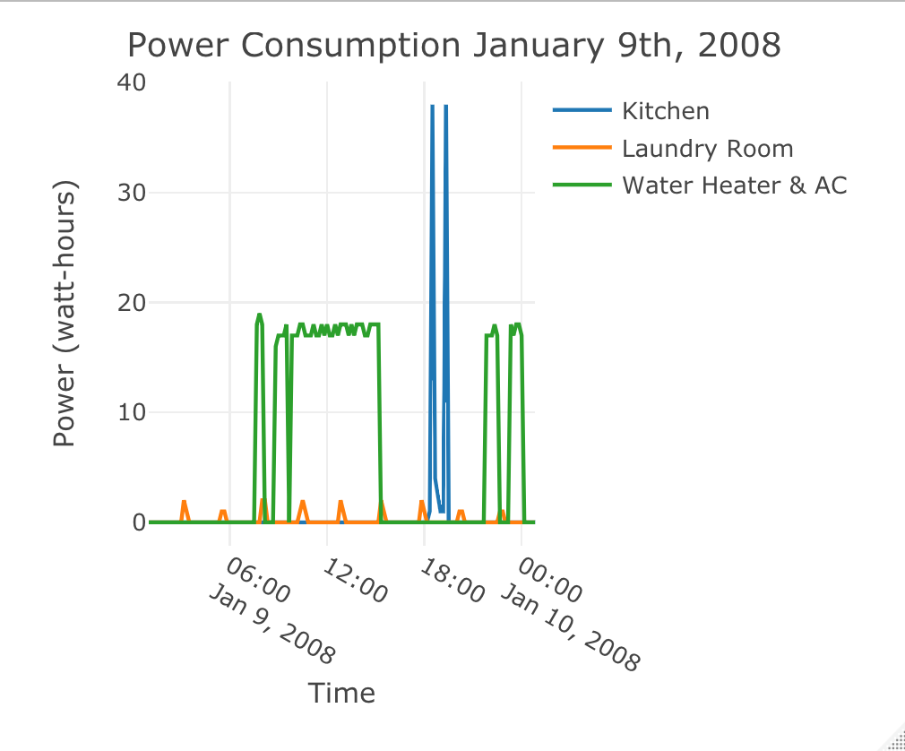
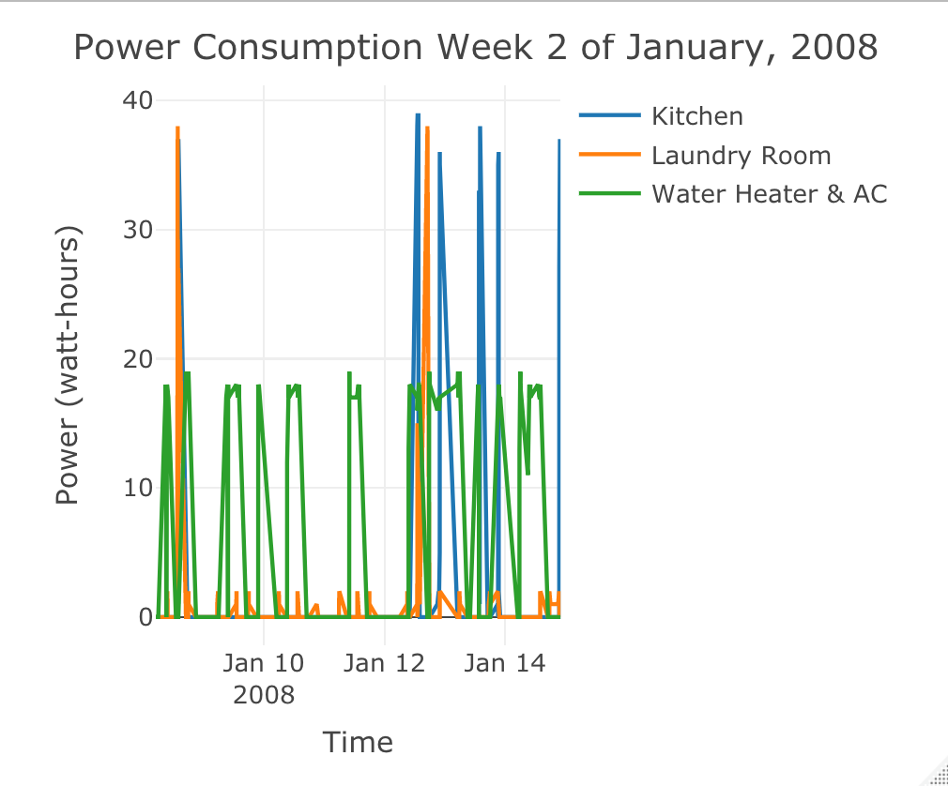
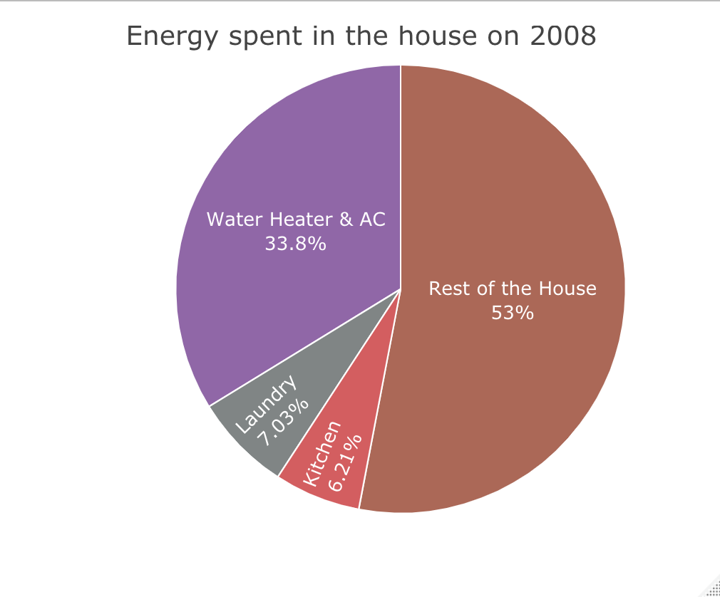
Power consumption in 2008
Kitchen used around 18:00
Kitchen mostly used on the weekends
Water heater & AC is the most used

Slide 3
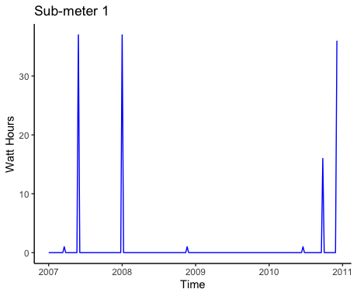
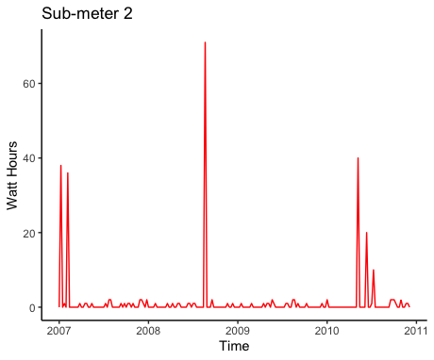
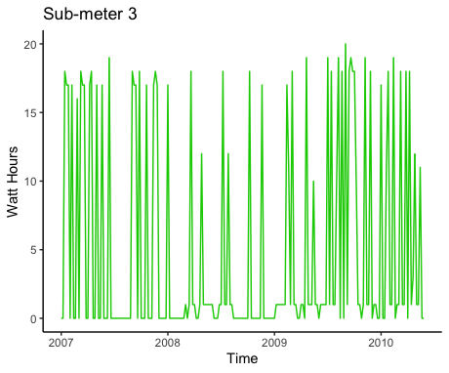
Power consumption registered from 2007 to 2010
The laundry room has a huge power consumption of 80 watt-hours between 2008 and 2009.
Water Heater & AC is used regularly with peaks up to 20 watt-hours.
The kitchen has peaks of less than 40 watt-hours.

Slide 4
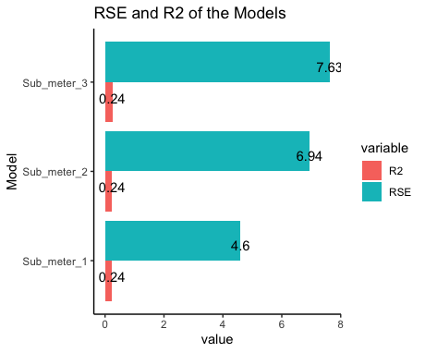
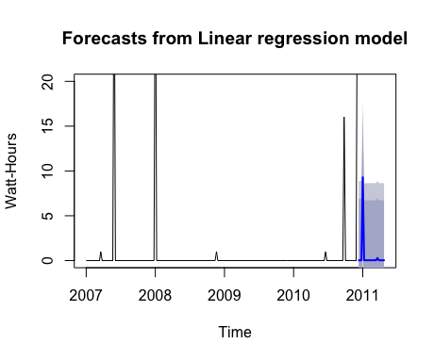
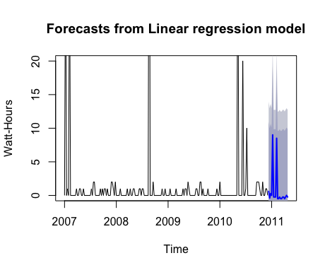
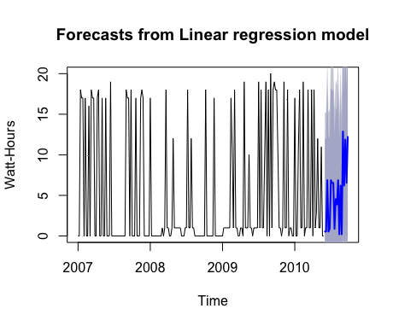
Forecast of power consumption using linear regression
All models forecats a lower consumption and have the same R^2.
The model that has smaller errors is the one that forecasts Sub_meter_3.
Kitchen
Laundry room
Water Heater & AC
Forecast for Sub_meter_1
Forecast for Sub_meter_2
Forecast for Sub_meter_3

Slide 5
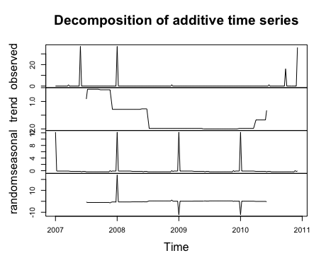
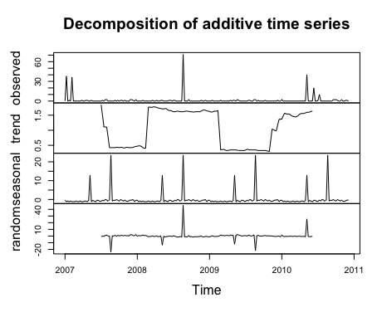
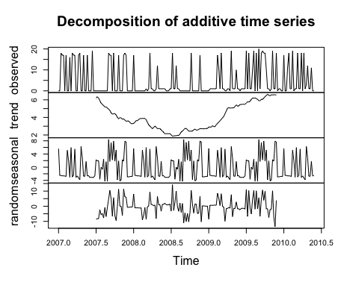
Decomposition of kitchen, laundry room and water heater & ac
Laundry shows an up and down trend. It also shows seasonality. Most used in August.
Water Heater & AC shows an up trend in the final two years and has seasonality. Used all the time.
Kitchen shows a down trend and seasonality. Most used in New Year.
Kitchen
Laundry room
Water Heater & AC

Slide 6
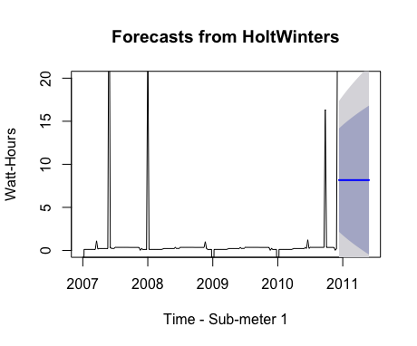
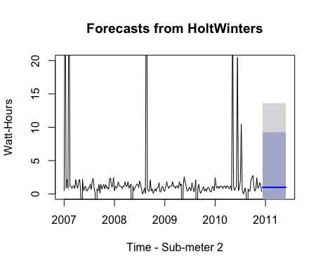
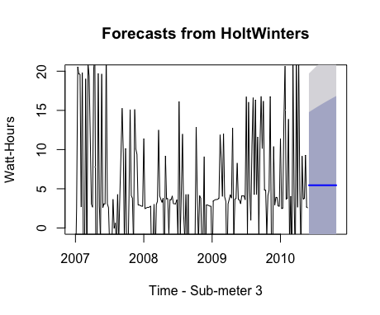
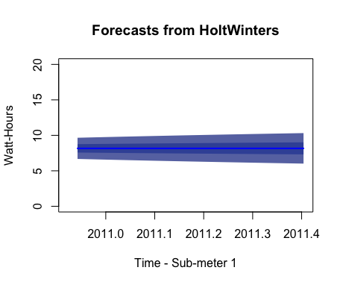
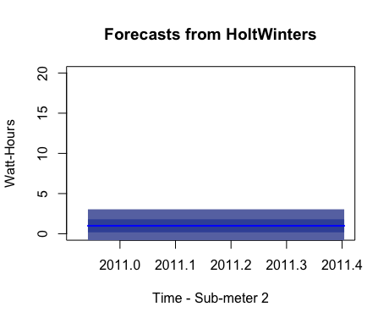
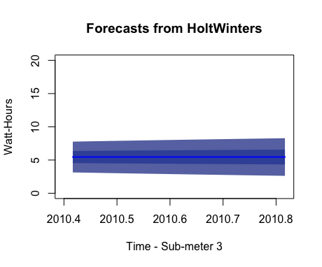
Forecast without the seasonal component
Kitchen
Laundry room
Water Heater & AC

Slide 7
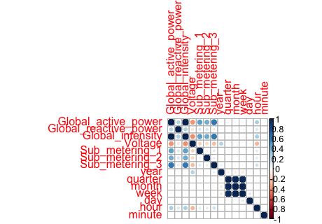
Correlations
The sub-metering 3 (Water Heater & AC) has a moderate correlation with the Global active power and the Global intensity.
The sub-metering 1 and 2 have a weak correlation to Global active power and the Global intensity.

Slide 8
Summary
The sub-meter 3 (water heater & ac) consumes the most energy in a year. It consumes less energy but more frequently.
The sub-meter 2 (laundry room) presents consumption mostly on weekends and it consumes a lot around August.
The sub-meter 1 (kitchen) presents consumption around 18:00 of a day (dinner time) and consumes a lot around the festivities of New Year.
The sub-meter 1 and 2 present very similar cosumption in a year.
It would be advantageous if other electronics like TVs could be added to another sub-meter.

Slide 9
5 recommendations
Cover more areas of the house like the living room, garage, and bedroom if there are any.
Do laundry one day in the middle on the week and on the weekends so that the power consumption isn’t as high, especially around August.
Use the ac on the summer and the water heater on winter to reduce the frequency it is used.
Use the dishwasher and microwave less frequently, so the power consumption is less in the kitchen, especially around New Year.
Start drying clothes on the sun so that the tumble-drier is used less frequently.

Slide 10
Lessons learned
Using time series is useful to view the chnages a variable has over time.
Each variable can have a trend and a seasonal component that supports a particular pattern.
The models that generate the forecasts have very little explained variance and the confidence intervals at 80 or 90 percent have a big amplitude.
The Holt Winters Forecasting is very useful for making predictions.

